Slide 1

Predicting Car Accidents in California, USA
K Thilanjan M Vithana
10/04/2020

Slide 2

Business Problem
How accurately can we model the severity of accidents in California State based on past accident data covering the US?
There is a growing interest in the correlation studies on the impact of weather on roadside accidents.
In a state like California, USA most of the population commute with their own automotive and far less use of public transport.
YoY there is an increase of traffic accidents.
It will be a good study to identify how much relatable a traffic accident in CA to rest of the US weather wise.

Slide 3
Data Acquisition and Cleaning
Data is obtained from Kaggle repository(https://www.kaggle.com/sobhanmoosavi/us-accidents) .
This is a countrywide car accident dataset, which covers 49 states of the USA.
The accident data are collected from February 2016 to June 2020.
Two APIs that provide streaming traffic incident (or event) data.
These APIs broadcast traffic data captured by a variety of entities, such as the US and state departments of transportation, law enforcement agencies, traffic cameras, and traffic sensors within the road-networks.
3.5 million accident records in this dataset.
Data Used for Analysis
A Random sample of 700,000 records out of the 3.5 Mn are selected to build the models.
The main data set is filtered by State=’California’ and the first 150,000 rows used to predict and evaluate model accuracy for California.

Slide 4
Data Acquisition and Cleaning (Contd)
Independent Variables
Measurement data such as Temperature (F), Precipitation(in) had many missing values.
Group the data by Year, Week (Week number), State, County and obtaining the mean at the most granular level to backfill missing data.
Rest of the missing data was populated with 0 on a as-needed basis.
Categorical data such as “Weather Condition” had multiple scenarios (122) that were re-grouped to four distinguishable groups (Clear, Overcast, Severe_rain, Severe_Snow)
Unclassifiable weather conditions were grouped as ‘Unknown’.
Main Feature set
Temperature(F) / Humidity(%) / Pressure(in) / Visibility(mi) / Wind_Speed(mph) /Precipitation(in) / Weather_Condition / Sunrise_Sunset

Slide 5
Main Data set fields

Slide 6
Data acquisition and cleaning…Contd
Weather Condition breakdown
Dependent variables
The main predicted variable is Severity. It holds the values 1 thru 4 based on ascending order of severity of the accident.
For this exercise severity is re-classified to binary format where Severity 1, 2 are mapped to 0 and 3, 4 are mapped to 1 in the data pre-processing stage.

Slide 7
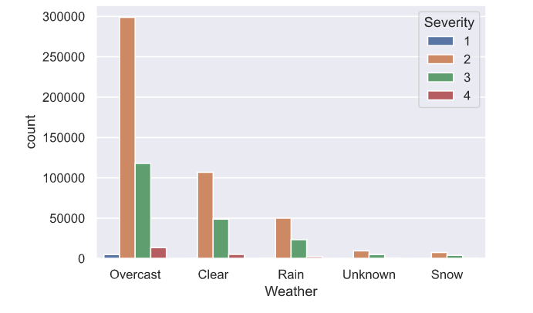
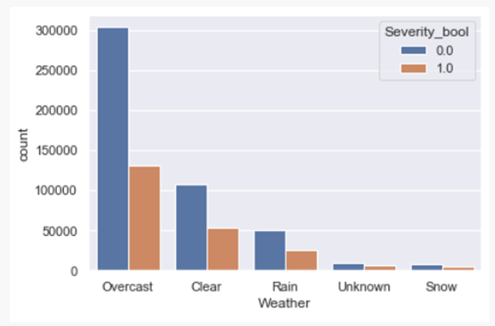
Data Visualization
Histograms for Weather Condition vs Severity
Most of the data points lie on Severity 1 and 2 (Severity 0 in binary format).
Please refer Appendix for continuous variable data visualization plots

Slide 8
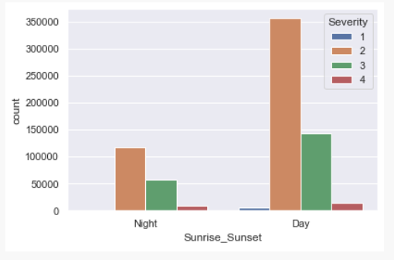
Data Visualization (Contd)
Histograms for Sunrise_Sunset vs Severity
Illustrates most of the accidents are severity 1 and 2 (Severity 0 in binary format) and happens during the day

Slide 9
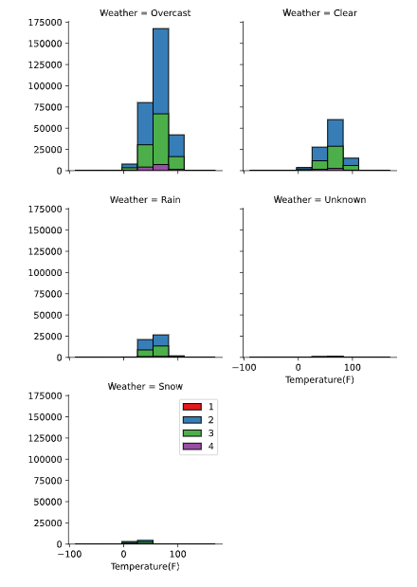
Continuous Variable example Temperature Histogram
This plot suggest the severity and quantity of the accidents increase with temperature when it is overcast
As observed in Histograms illustrated on previous slides, most of the data lie in Overcast Weather condition

Slide 10
Predictive Modelling and Results
This is a binary classification problem, and the following models were selected to create multiple models and evaluate each of their performance/accuracy of predicting accidents for CA. These models were selected as there is a large data set to process .
Decision Tree
Logistic Regression
K Nearest Neighbor(KNN)
Support Vector Machine

Slide 11
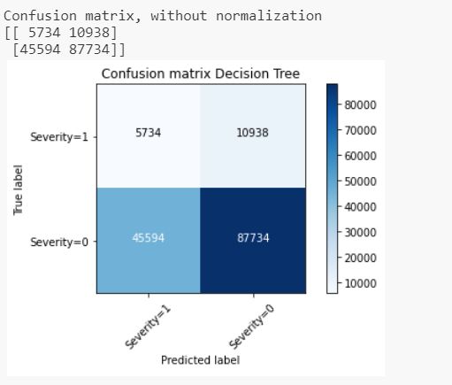
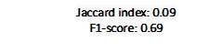
Decision Tree Model and Performance

Slide 12
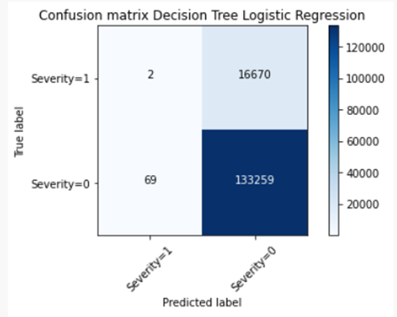
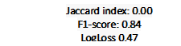
Logistical Regression Model and Performance

Slide 13
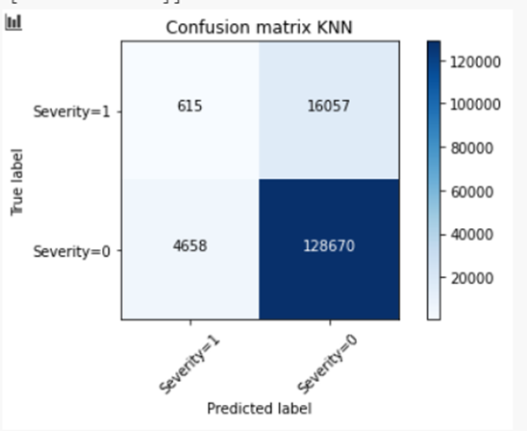
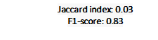
k Nearest Neighbor Model and Performance (k=15)

Slide 14
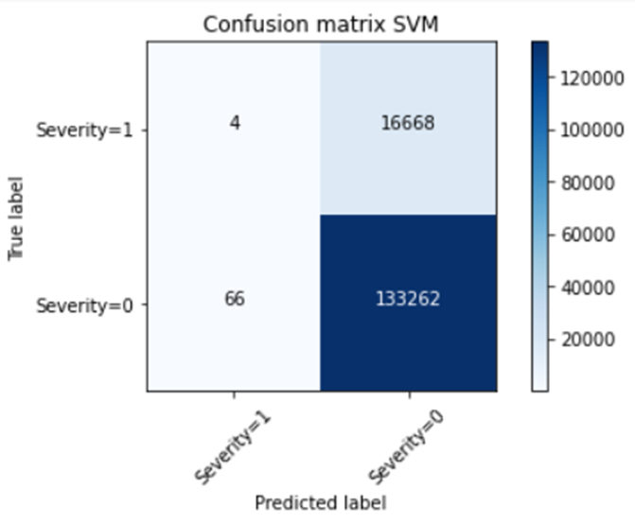

Support Vector Machine Model and Performance

Slide 15
Observations Summary
 | Decision Tree | Logistic Regression | K Nearest Neighbor | Support Vector Machine
Jaccard index | 0.09 | 0.00 | 0.03 | 0.00
F1-score | 0.69 | 0.84 | 0.83 | 0.84
LogLoss |  | 0.47
Decision Tree Model -Jaccard index: 0.09 / F1-score: 0.69 -Slightly better model to estimate a severe accident but a better model to estimate less severe accident due to weather condition
Logistic Regression -Jaccard index: 0.00 LR F1-score: 0.84 LR LogLoss: 0.47 - Low accuracy predicting a severe accident (3, 4) but higher accuracy for predicting a less severe accident (1, 2)
K Nearest Neighbor - Jaccard index: 0.03 KNN F1-score: 0.83 - Low accuracy predicting a severe accident (3, 4) but higher accuracy for predating a less severe accident (1, 2)
Support Vector Machine - Jaccard index: 0.00 SVM F1-score: 0.84 - Low accuracy predicting a severe accident (3, 4) but higher accuracy for predicting a less severe accident (1, 2)

Slide 16
Conclusion
Accuracy levels of predicting a severity or 3 and 4 level accident is at its lowest levels.
Accuracy of predicting a severity 1 or 2 is very high.
In conclusion, this project can be summarized as follows to answer the business problem.
yes, it is possible to model and predict accident severity of California based on US National data up to a severity of low to medium.
Best model to use to predict less severe accidents would be
Logistic Regression
kNN Model
Support Vector Machine

Slide 17
Future Directions
Following suggestions can be made based on the data and the predictions
Use localized samples for train model. E.g.: CA only train/test data
Increase the number of samples out of US National data
Increase the number of samples to predict from CA
Revisit the weather condition grouping for better grouping.
Run separate model for measurable values such as Temperature / Pressure etc.
Run separate model for categorical values of weather condition vs Severity

Slide 18
References
https://medium.com/@prashantchaturvedi2020/accuracy-of-classifier-db5d9cff0a21
https://stackoverflow.com/questions/46391128/pandas-fillna-using-groupby
https://clay-atlas.com/us/blog/2019/10/27/python-english-tutorial-solved-unicodeescape-error-escape-syntaxerror/

